Slide 1
Whole-Link Make your life better​
Abishek​ Arpan ​
Li Jie ​ Mao Qin ​
Xia Yinjie​ Qu Zhaowen

Slide 2
Table of contents
01
Project purpose
04
Technical demonstration
02
Requirements analysis
05
Project management
03
Function demonstration
06
Challenges of APP

Slide 3
----Team NICKEL
Making lives better through the Internet of Things, connecting everything seamlessly."

Slide 4
Requirements analysis
2.

Slide 5
Requirements
Account registration
Room control
Login/logout
Support resources
History record
Contact support
Devices control
User-friendly interface.

Slide 6
3.
Function demonstration

Slide 7
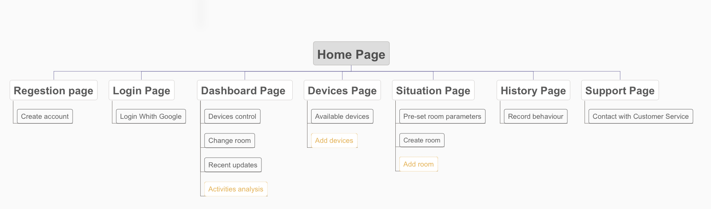
site architecture
* Yellow part is the function we will finish in the future

Slide 8
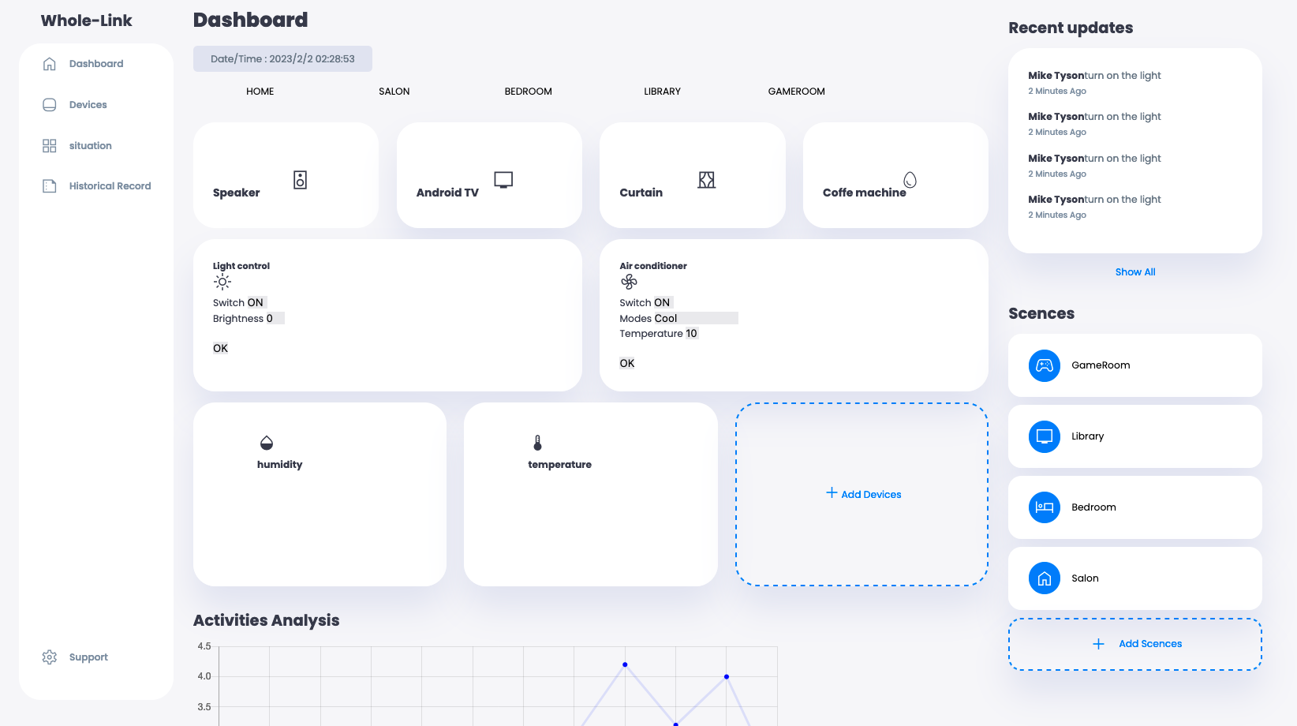

Slide 9
Technical demonstration
4.

Slide 10
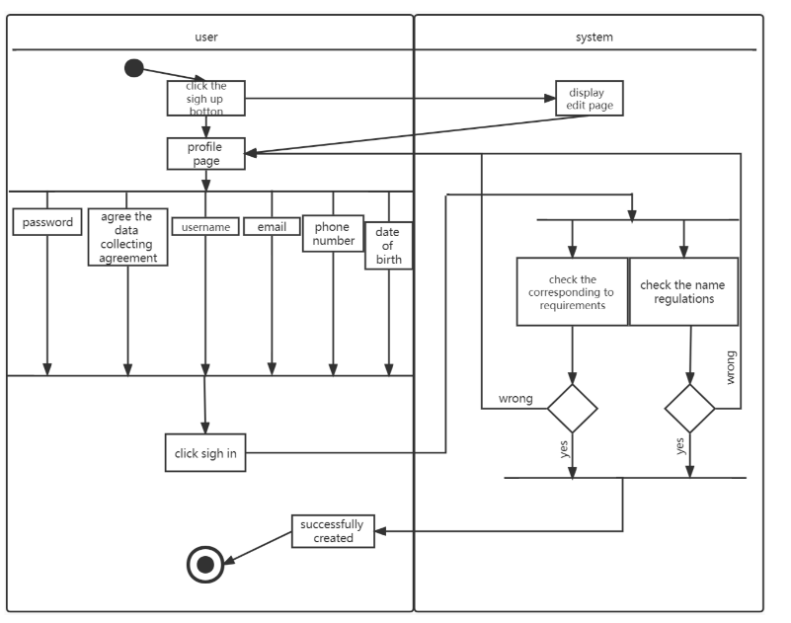

Slide 11
Project management
5.

Slide 12
Our Team
LI Jjie
XIA Yinjie
QU Zhaowen
Mao Qin
Abishek
Arpan
Project Manager
Back-end Developer
Front-end Developer
Technical Writer
User Experience Designer
Documentation Coordinator

Slide 13
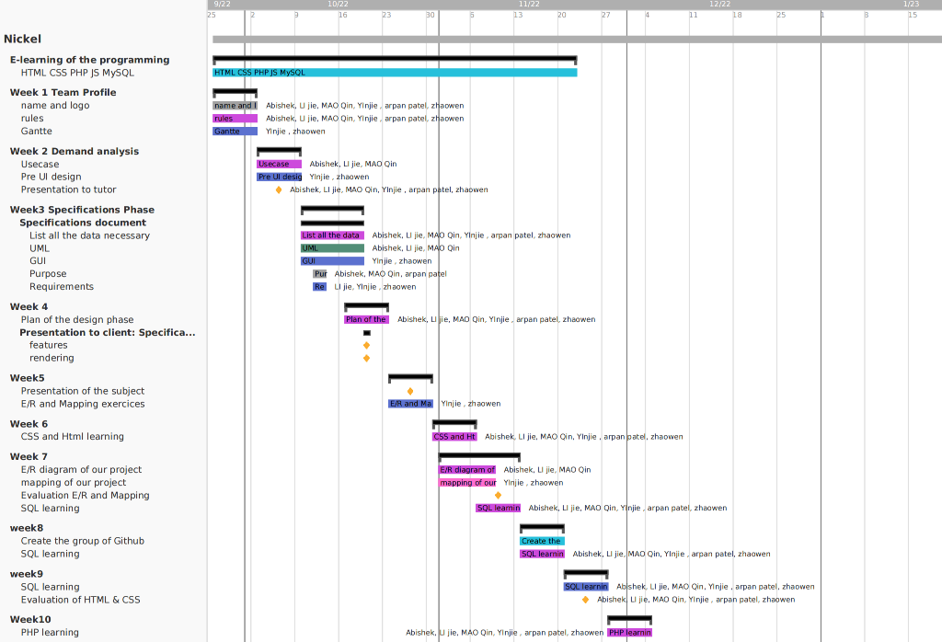

Slide 14
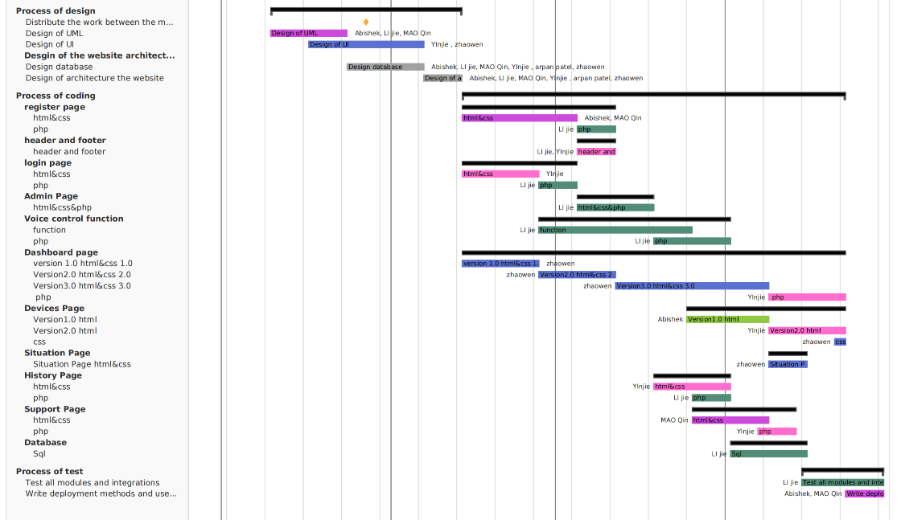

Slide 15
Tools
01
Wamp/Xampp
Local dev environments for web apps.
Chrome & Firefox
02
Web browser for testing and debugging.
03
VS code
Code editor for development.
Gantt Chart & Trello
04
Manage project progress and schedules
05
Figma
Design ui and ux

Slide 16
CHALLENGS
6.

Slide 17
Challenges
Technical difficulties
Quality assurance
Managing change requests
Collaboration and coordination
Ensuring that the website meets the requirements, performs optimally, and is free of bugs and errors is a crucial but challenging aspect of web development.
Complex technical issues can arise during the development process, such as compatibility problems between different technologies, integration difficulties, and performance issues.
Collaborating effectively with team members can be difficult, particularly when working with remote teams or dealing with conflicting schedules.
Dealing with changes and modifications to the project scope and requirements can be a challenge, as it may impact the project timeline .

Slide 18
Thanks!

